Slide 1
Roadmap for the S-100 Implementation
Abri Kampfer International Hydrographic Organization

Slide 2
S-101 ENC: the future premium product
Characteristics of S-101 ENCs:
- minimal modernization of cartographic content compared to S-57 ENC
- easier software maintenance on end user devices at sea
- cyber secure through modern encryption
- supports the implementation of e-navigation concepts through interoperability with other data services based on S-100:
high definition bathymetry (S-102)
water level information (S-104)
surface currents (S-111)
Marine protected areas (S-122)
Radio services (S-123)
Navigational warnings (S-124)
UKC management (S-129)
Notes:
S-101 is the new product specification for Electronic Navigational Chart (ENC) datasets based on the overarching S-100 framework standard. The development of S-101 reflects the experience of
stakeholder feedback with regard to the current limitations of S-57 based ENCs. The ultimate goal is that an S-101 ENC will provide the base chart layer in ECDIS for S-100 integrated products and the underpinning of e-navigation. Its full potential will be realised as other types of products used within the maritime domain, such as aids to navigation, vessel traffic services, oceanography and meteorology, etc., adopt the concept and develop interoperable products and services modelled along the S-100 framework as well.

Slide 3
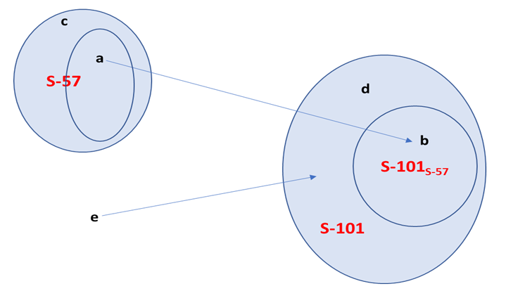
S-57 to S-101 conversion – feature categories
(a) Things in S-57 which can be translated into an S-101 equivalent without loss
(b) The domain of features defined by the S-57 source
(c) Anything in S-57 which can’t be (or doesn’t need to be) translated into an S-101 equivalent
(d) Features defined in S-101 which has no defining mechanism in S-57
(e) Real world features which previously had no representation in S-57 which are now expressible in S-101 (these are encoded into features (d)).
The Universe…
Notes:
S-101 compliant ENCs are not a radical reengineering of the S-57 concept. S-101 retains most of the characteristics that are currently used in S-57 ENCs, but also improves those elements of S-57 that benefit from the flexible framework, which has been established under S-100 and aligned with the current ISO 19100 series of geospatial standards.

Slide 4
Coordinated implementation of S-101 ENC services
S-101 ENC can be produced in two ways:
- Conversion of S-57 datasets without essential manipulation:
Cartographic content will be identical for S-57 ENC and resulting S-101 ENC. S-57 ENC Conversion will create a fully valid S-101 ENC.
- Export from matured database production systems:
Cartographic content can be identical with S-57 ENC of the same sea area, or slightly enriched by some specific geometric features and attributes if the producer does so.
“Duel fuel” is a must to service legacy systems in the field.
Notes:
The IHO S-101 ENC product specification will be technically ready and exhaustively tested for regular production of S-101 ENCs by the end of 2022. The IHO Council at its third session in October 2019 endorsed the concept of the regular production and distribution services for S-100 based products commencing with the provision of substantive geographic coverage of S-101 ENC in 2024 in parallel to the established production of S-57 ENCs
In order to maintain ECDIS devices already installed on SOLAS vessels which are technically not ready nor required to be upgraded to S-101 ENC compatibility, and to comply with the applicable IMO regulations pertaining to existing navigation equipment, identical geographic coverage will be provided for S-57 ENCs and S-101 ENCs for a transition period until there is no significant amount of legacy systems in the field and all ECDIS in operation have become S-101 compatible.

Slide 5
S-101 ENC as the future fuel for IMO ECDIS
Arguments for IMO to accept S-101 ENC as official digital chart data featuring ECDIS:
- S-101 offers minimal modernization of cartographic content compared to S-57: both formats maintain the same level of cartographic content for safety of navigation.
- supports the implementation of e-navigation concepts through interoperability with other data services based on S-100.
- cyber secure through modern encryption.
Notes:
At the 7th IMO Sub-Committee on Navigation, Communications and Search and Rescue 7th Meeting presenting a status of IHOʹs ECDIS-related standards and a roadmap for the introduction of the next generation of S-101 Electronic navigational charts (ENC); explaining the resulting implications for existing and new ECDIS installations; and proposing consideration of amendments to resolution MSC.232(82) on Revised Performance Standards for Electronic Chart Display and Information Systems (ECDIS) to include references to the S-100 framework and the Product Specification S-101. The Sub-Committee acknowledged the ongoing efforts of IHO to develop and test S-100 based data product specifications, as well as the proposed introduction of IHOʹs S-101 ENCs as a transfer standard for official charts in ECDIS. NCSR 7 agreed that the amendments to resolution MSC.232(82) could be considered at the 8th session of NCSR in 2021 under the existing output on the Committee's post-biennial agenda on "Revision of ECDIS Guidance for good practice (MSC.1/Circ.1503/Rev.1)"

Slide 6


Any Questions ?
https://iho.int

